Slide 1
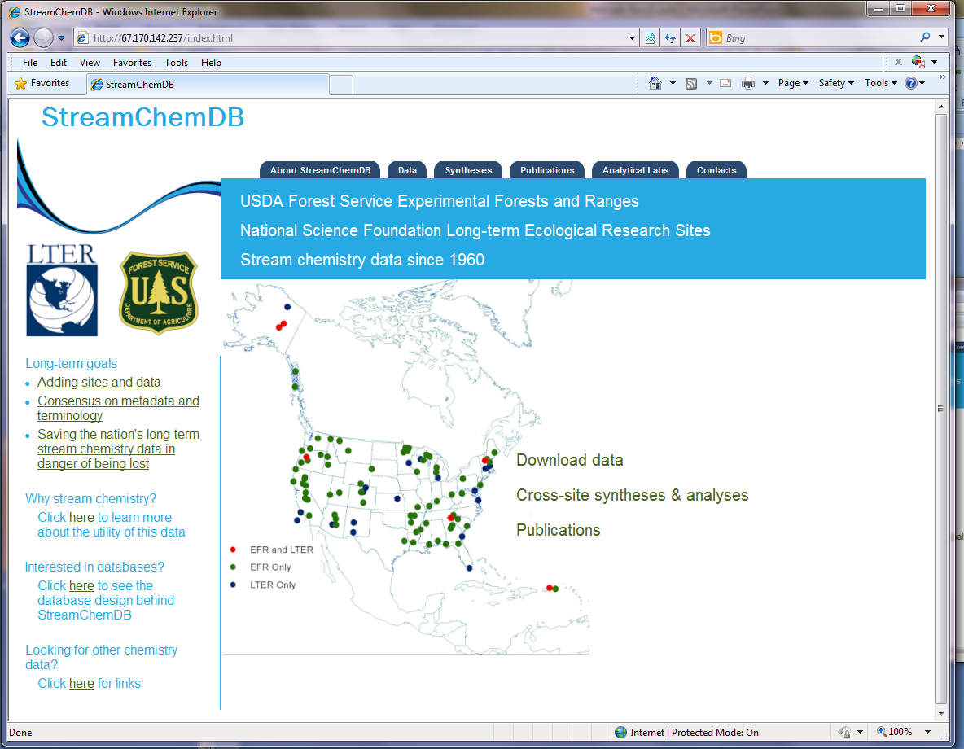

Slide 2



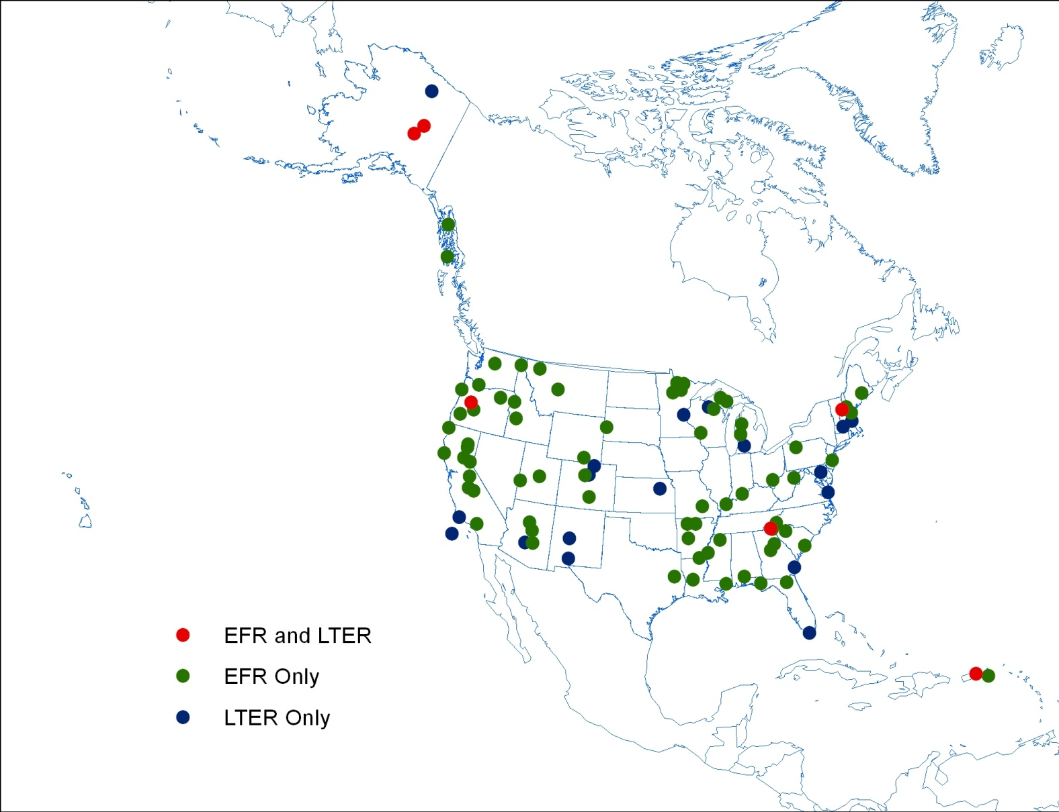
StreamchemDB
Luquillo Experimental Forest/LTER
CLOSE x
About StreamchemDB
Data
Syntheses
Publications
Analytical labs
Contacts
USDA Forest Service Experimental Forests and Ranges
National Science Foundation Long-term Ecological Research Sites
Stream chemistry data since 1960
Basins
Analytes
Rio Sabana (RS)
Rio Espiritu Santo (RES4)
Rio Mameyes Puente Roto (MPR)
Rio Mameyes Gage (MG)
Rio Icacos (RI)
Quebrada Toronja (QT)
Quebrada Sonadora (QS)
Quebrada Prieta (QP)
Quebrada Prieta A (QPA)
Quebrada Prieta B (QPB)
Quebrada Guaba (QG)
Quebrada Bisley 1 (Q1)
Quebrada Bisley 2 (Q2)
Quebrada Bisley 3 (Q3)
Ammonium
Calcium
Chloride
Conductivity
Dissolved inorganic carbon
Dissolved organic carbon
Dissolved organic nitrogen
Magnesium
Nitrate
pH
Potassium
Soluble reactive phosphorus
Total dissolved nitrogen
Total dissolved phosphorus
x
x
x
Long-term goals
Adding sites and data
Consensus on metadata and terminology
Saving the nation’s long-term stream chemistry data in danger of being lost
Key researchers: William McDowell, Clyde Asbury, (more)
About this site
Photos of site
Graph a different basin pair or parameter
Download this data
Key references: McDowell & Asbury 1994, Schaefer et al. 2000, (more)
(Click on sites for more info)
Why stream chemistry?
Download data
Click here to learn more about the utility of this data
Interested in databases?
Cross-site syntheses & analyses
Click here to see the database design behind StreamchemDB
Publications
Looking for other chemistry data?
EFR sites
LTER sites
Click here for links
LTER-EFR sites

Slide 3
StreamchemDB
Luquillo Experimental Forest/LTER
CLOSE x
About StreamchemDB
Data
Syntheses
Publications
Analytical labs
Contacts
Sonadora (QS) and Toronja (QT) watersheds
USDA Forest Service Experimental Forests and Ranges
National Science Foundation Long-term Ecological Research Sites
Stream chemistry data since 1960
Long-term goals
Adding sites and data
Consensus on metadata and terminology
Saving the nation’s long-term stream chemistry data in danger of being lost
Key researchers: William McDowell, Clyde Asbury, (more)
About this site
Photos of site
Graph a different basin pair or parameter
Download this data
Key references: McDowell & Asbury 1994, Schaefer et al. 2000, (more)
(Click on sites for more info)
Why stream chemistry?
Download data
Click here to learn more about the utility of this data
Interested in databases?
Cross-site syntheses & analyses
Click here to see the database design behind StreamchemDB
Publications
Looking for other chemistry data?
EFR sites
LTER sites
Click here for links
LTER-EFR sites

Slide 4
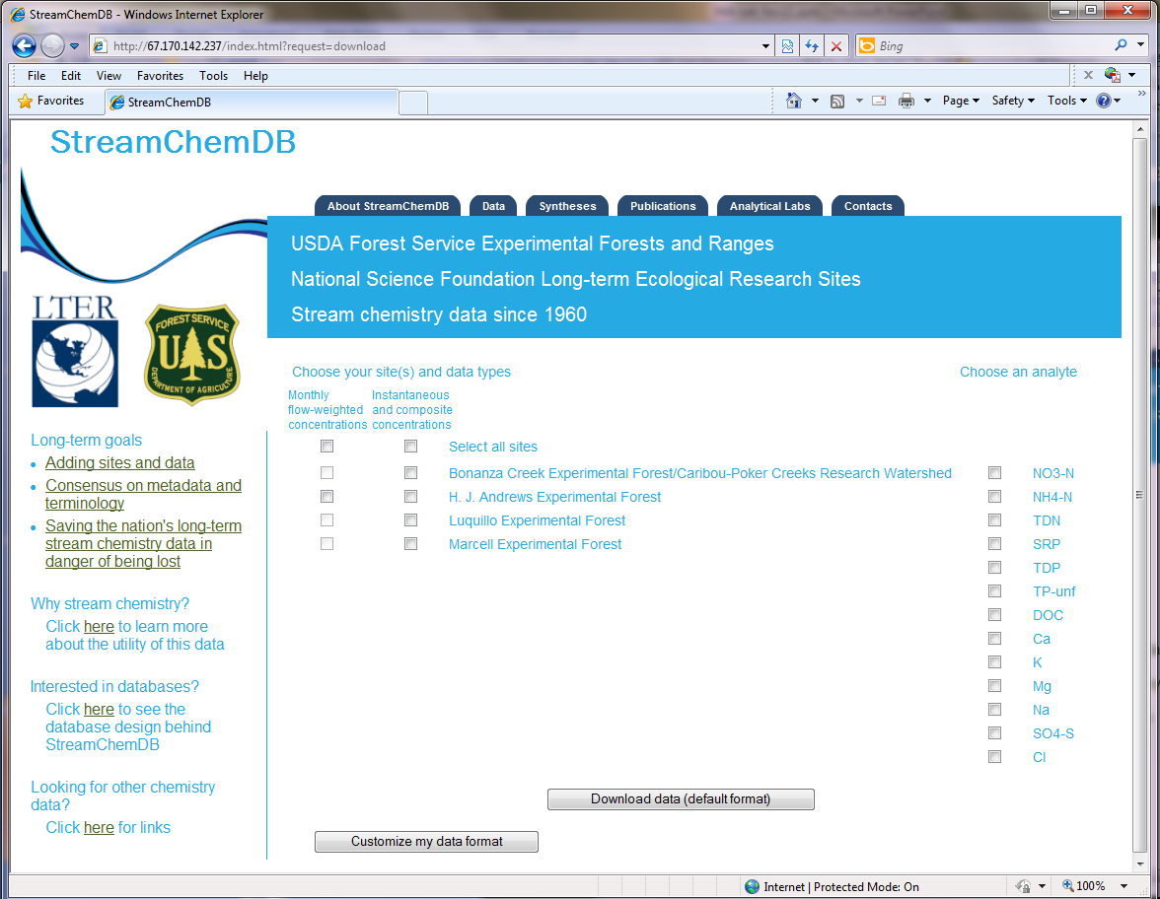
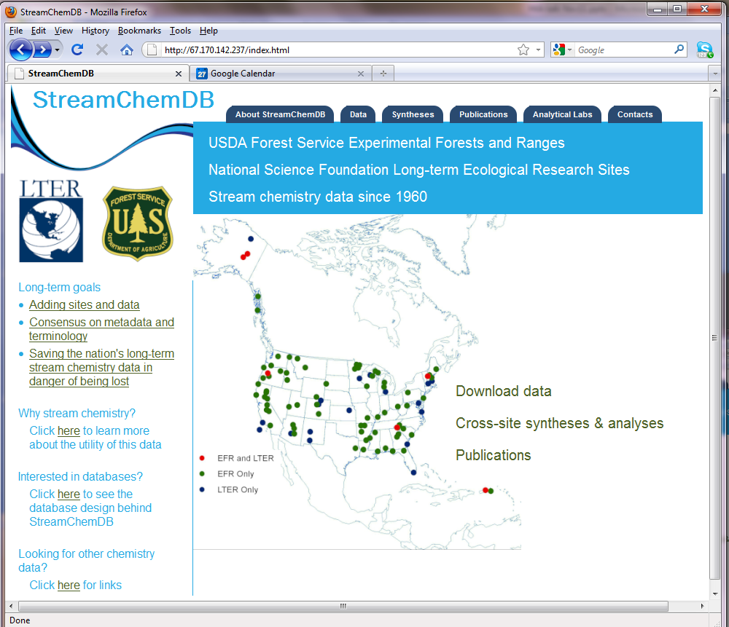

Slide 5
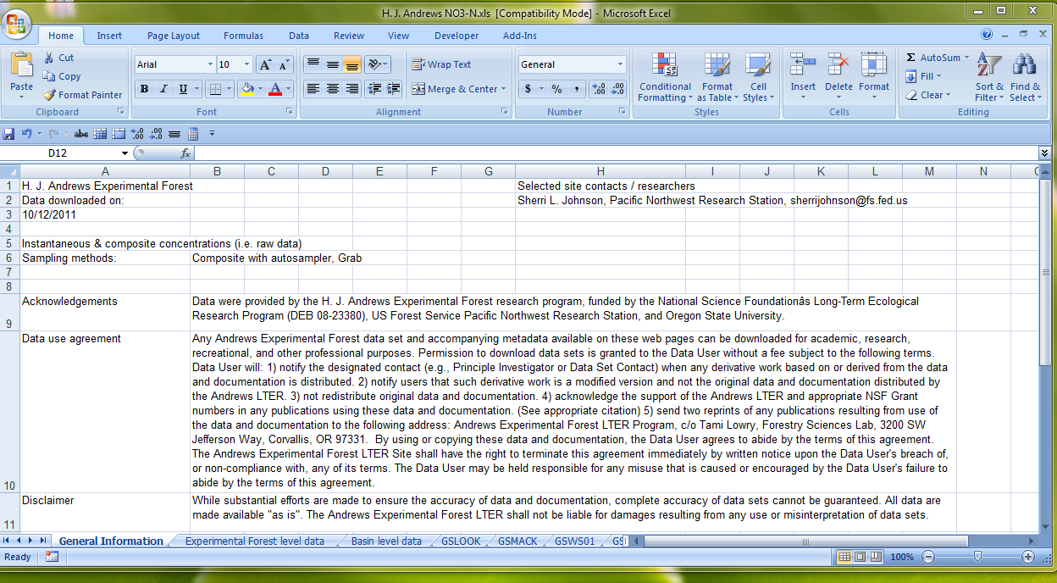

Slide 6
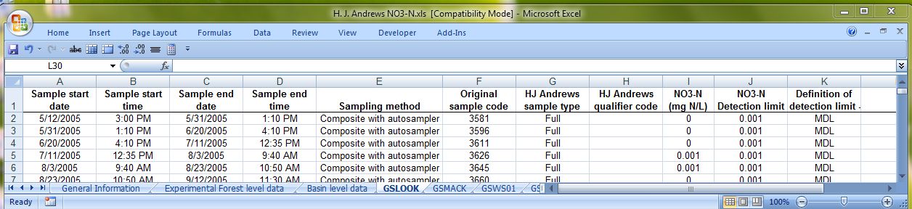

Slide 7
StreamChemDB
Coweeta
Fernow
Fraser
Andrews
Hubbard Brook
Luquillo
Marcell
San Dimas
Santee
Tenderfoot
Earliest year of stream chemistry data available:
Bonanza
Nitrate | 1986 | 1971 | 1969 | 1970 | 1968 | 1964 | 1983 | 1966 | 1979 | 1976 | 1992
Ammonium | 1995 | 1971 | 1970 | 1982 | 1968 | 1964 | 1983 | 1967 | 1979 | 1976 | 1993
Dissolved | 1995 | 2005 |  | 2005 | 1968 | 1995 |  | 1967 |  | 1976
Unfiltered |  |  |  | 1990 | 1978 |  | 1993 | 1967 |  |  | 1993
Orthophosphorus | 1999 | 1971 |  | 1982 | 1968 | 1972 | 1989 | 1969 |  | 1976
Dissolved |  |  |  | 1983 | 1968 |  | 1983 |  |  | 2003
Unfiltered |  | 2008 |  |  | 1974 |  |  |  |  |  | 1992
Anions (Cl, S0₄) | 1986 | 1969 | 1969 | 1965 | 1968 | 1963 | 1983 | 1964 | 1979 | 1976 | 1992
Cations (Ca, Mg, K, Na) | 1986 | 1971 | 1969 | 1970 | 1970 | 1964 | 1983 | 1967 |  | 1976 | 1992
Conductivity | 1995 |  | 1960 | 1982 | 1970 |  | 1983 | 1964 |  | 1976 | 1992
pH | 2002 | 1971 | 1960 | 1982 | 1968 | 1963 | 1983 | 1964 |  | 1976 | 1992
Alkalinity/carbonate | 1986 | 1971 | 1976 | 1984 | 1968 |  |  | 1967 |  | 1976 | 1992
Silica | 1986 | 1971 |  | 1970 | 1969 | 1964 | 1983
Carbon | 1995 | 1979 |  | 1990 | 2001 | 1995 | 1983 | 1966 |  | 2004
Total N
Total P
Notes:
Orthophosphorus: Soluble reactive phosphorus and/or orthophosphorus by IC
Total N: Kjeldahl and/or Total Nitrogen by alkaline persulfate method
Carbon: Various forms of carbon: dissolved organic, dissolved inorganic, particulate organic, total organic
Additional analytes collected by one or two sites: Al, F, Fe, Mn, Color, Nitrite, Hardness

Slide 8
StreamChemDB
DATABASE DESIGN
Methods & parameter tables
Sites
Basins
Data tables

Slide 9
StreamChemDB
DATABASE DESIGN
Methods & parameter tables
Sites
Basins
Data tables
Site web sites
Contacts
Site disclaimers & agreements
Status of the data

Slide 10
StreamChemDB
DATABASE DESIGN
Methods & parameter tables
Sites
Basins
Data tables
Site web sites
Disturbances
Disturbance details
Contacts
Site disclaimers & agreements
Status of the data

Slide 11
StreamChemDB
DATABASE DESIGN
Methods & parameter tables
Sites
Basins
Data tables
Site web sites
Disturbances
Discharge
Disturbance details
Contacts
Samples
Chem data instantaneous & composite conc
Site disclaimers & agreements
Status of the data
Chem data monthly derived conc

Slide 12
StreamChemDB
DATABASE DESIGN
Methods & parameter tables
Sites
Basins
Data tables
Site web sites
Disturbances
Discharge
Sampling methods
Disturbance details
Contacts
Samples
Detection limits
Chem data instantaneous & composite conc
Site disclaimers & agreements
Precision
Units
Parameters
Status of the data
Chem data monthly derived conc
Analytes
Analytical methods
Notes:
Afegir
cv internannual vs trends- Sen Slope’s
cs intraannual vs trends –Sen Slope’s

Slide 13
StreamChemDB
DATABASE DESIGN
Methods & parameter tables
Sites
Basins
Data tables
Site web sites
Disturbances
Discharge
Sampling methods
Disturbance details
Contacts
Samples
Detection limits
Chem data instantaneous & composite conc
Site disclaimers & agreements
Precision
Units
Parameters
Status of the data
Chem data monthly derived conc
Analytes
Analytical methods
Major methods
NEMI methods
Labs
Instruments

Slide 14
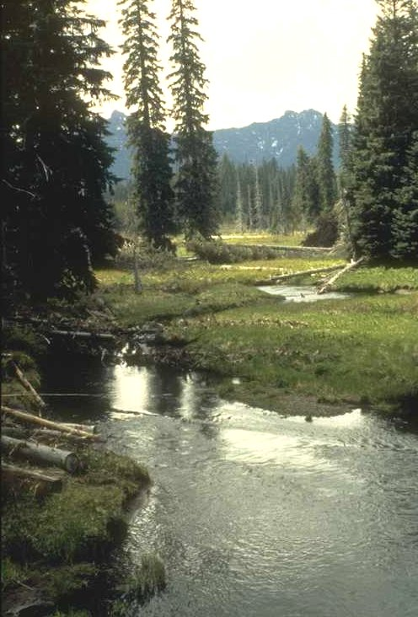



Questions?
For more information: http://http://web.fsl.orst.edu/streamchem/

